Slide 1

Electricity Forecast Austria
By Jonas Welt, Karim Ortner & Lorenz Johannes Schlosser

Slide 2
Contributions & GitHub
Jonas – Data Preprocessing
Karim – dataset aquisition, presentation
Lorenz - dataset aquisition, project structure
Github: https://github.com/LSchlosser/TIS3_CapstoneProject/tree/main/data

Slide 3

Business Problem
Problem
Austrian electricity prices fluctuate daily due to supply-demand, renewable generation, and market dynamics
Forecasting helps:
Utilities optimize procurement and trading
Businesses schedule energy-intensive operations efficiently
Policymakers monitor costs and plan subsidies
Value
Accurate forecasts lower financial risk; a 5–10% error reduction can save millions. Confidence intervals quantify uncertainty.

Slide 4
Solution
Steps Taken:
Data Engineering
Exploratory Data Analysis
Feature Engineering
Modeling
Evaluation
Forecast

Slide 5

Data source & description
Source: European wholesale electricity price data (daily)
Link: https://ember-energy.org/data/european-wholesale-electricity-price-data/
Scope: Austria
Variables: Date, Price (EUR/MWh)
Processing: Aggregate daily → monthly averages, add lagged/additional features

Slide 6
Insights
Historical trends & seasonality (higher prices in winter, lower in summer)
Spikes are short-lived → market shock events
Clear year-over-year upward trend, especially after 2021 (energy crisis)
Holiday periods can distort demand (e.g., Christmas, New Year)

Slide 7
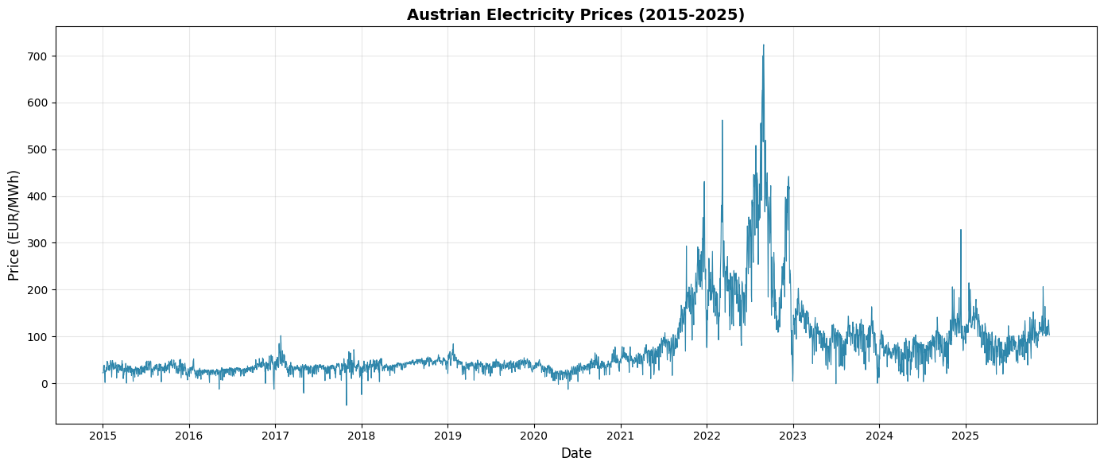
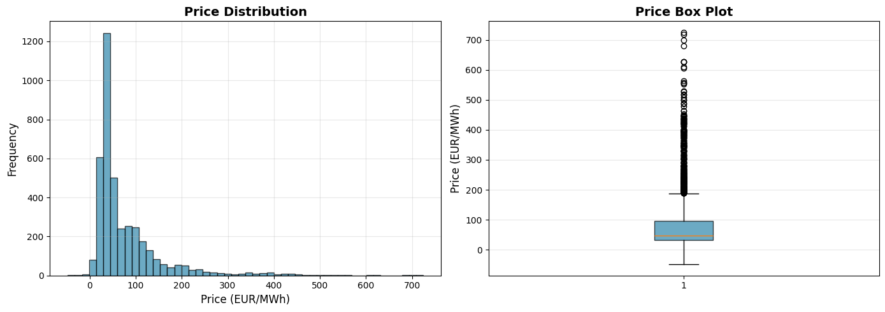
Insights

Slide 8
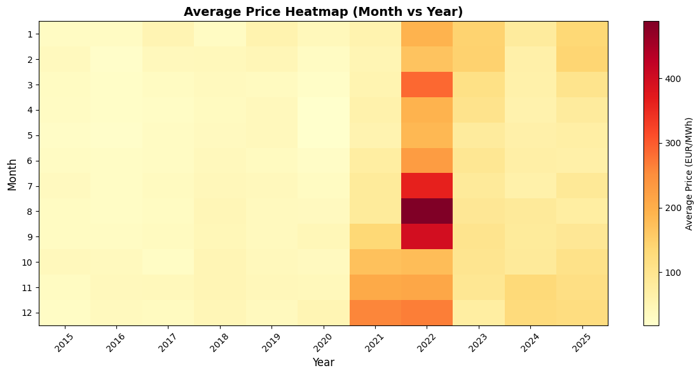
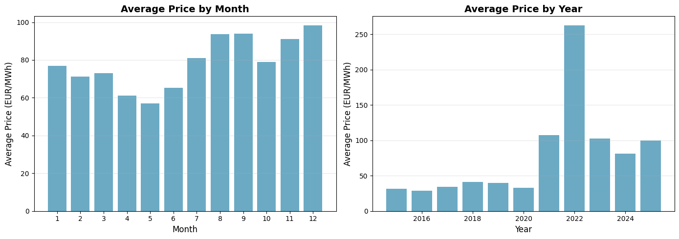
Insights

Slide 9
Data Engineering
Filter data for AUT
Standardize schema to “unique_id”, “ds” & “y”
Two frequencies prepared:
Daily : original daily prices used to train daily forecasting models
Monthly : daily prices aggregated to monthly averages and used to train monthly forecasting models
Chronological split to prevent data leakage:
Training: data before January 2025
Validation: January–December 2025
Test: reserved for future evaluation (2026 onward)
Same split strategy applied to both daily and monthly datasets

Slide 10
Data Engineering
For Evaluation:
Daily forecasts aggregated to monthly averages for evaluation
Monthly models evaluated directly
Enables fair comparison of forecasting approaches
For Reproducibility:
Preprocessed data stored as CSV files
Cached loading for consistent results

Slide 11
Modeling
Algorithms & Why
----
Model Selection
----

Slide 12
Evaluation
Metrics: RMSE, MAE, MAPE
Visuals: Predicted vs actual, residuals, prediction intervals
Quality & Uncertainty: Confidence intervals included, limitations noted (rare spikes, market shocks)

Slide 13
Forecast
January 2026 price prediction for Austria
Show 95% confidence intervals
Visualize forecast on time-series plot

Slide 14
Value/ Decision-Making
Actions enabled:
Schedule energy procurement in advance
Adjust trading strategies
Optimize energy-intensive production
Impact:
Reduced costs due to better planning
Mitigate risks from price spikes
Without forecasts → reactive decisions, higher costs

